Slide 1
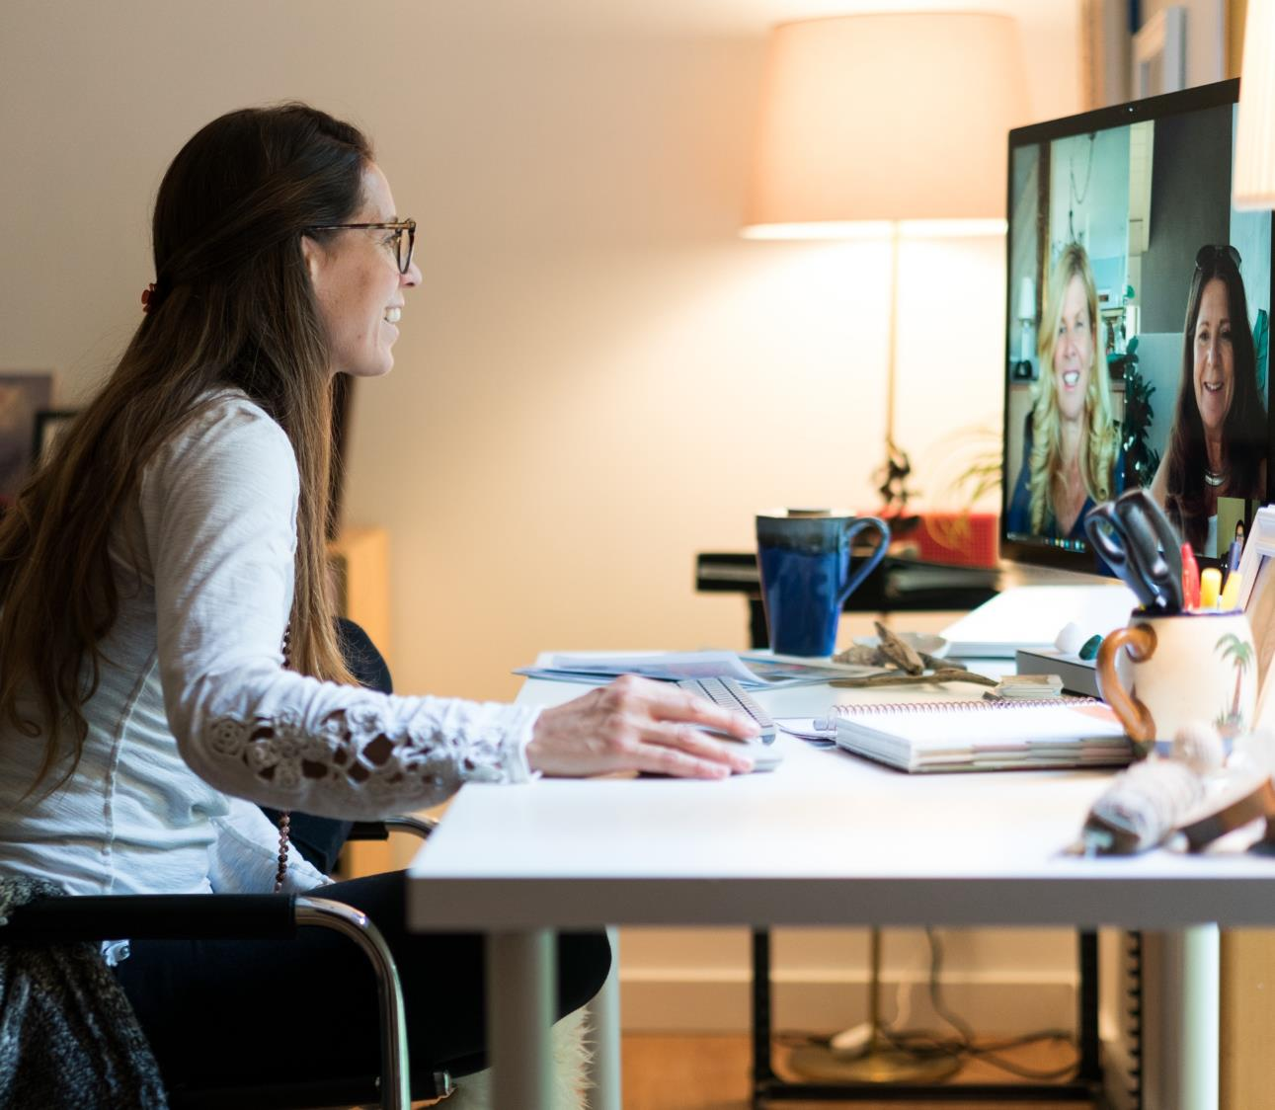
05 Digital Event Key Learnings

Slide 2
Key Learnings

Slide 3
Key Learnings
Don’t Translate, Remake

Slide 4
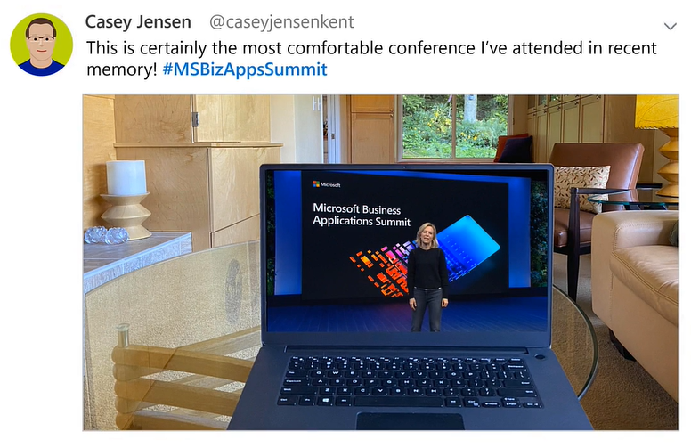
Key Learnings
Before, attendees came to us. Now, we’re in their living rooms
Don’t Translate, Remake

Slide 5
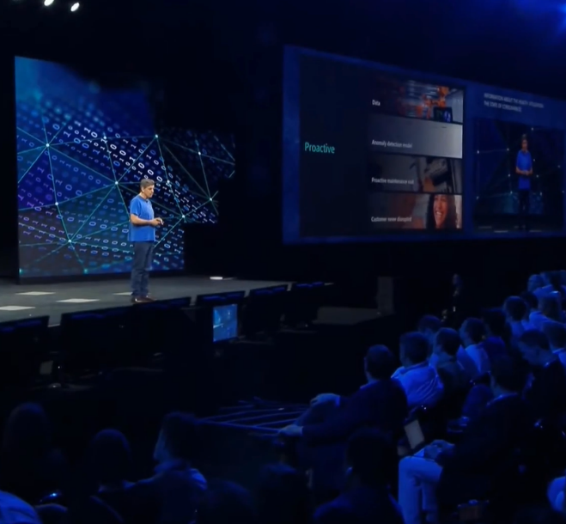
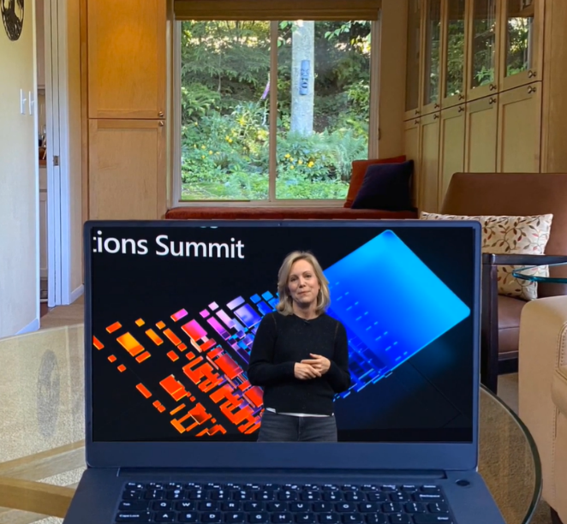
Key Learnings
Space between presenter and attendees compresses from venue hall to laptop distance
Don’t Translate, Remake

Slide 6
Key Learnings
Don’t Translate, Remake
Re-think your runway

Slide 7
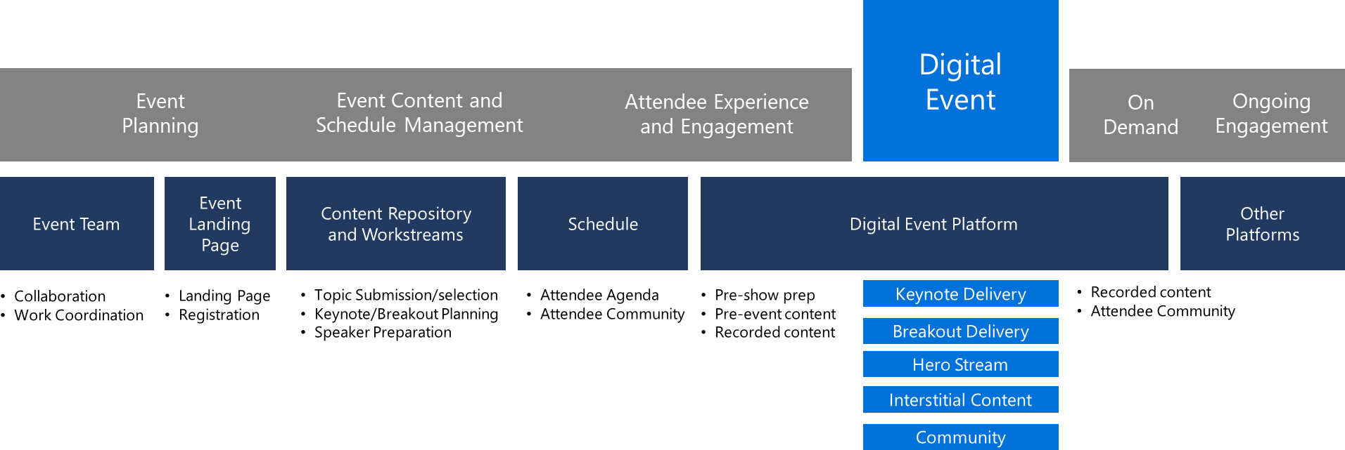
Key Learnings
Run-up to an event is a critical period for engagement and energy
Don’t Translate, Remake
Re-think your runway

Slide 8
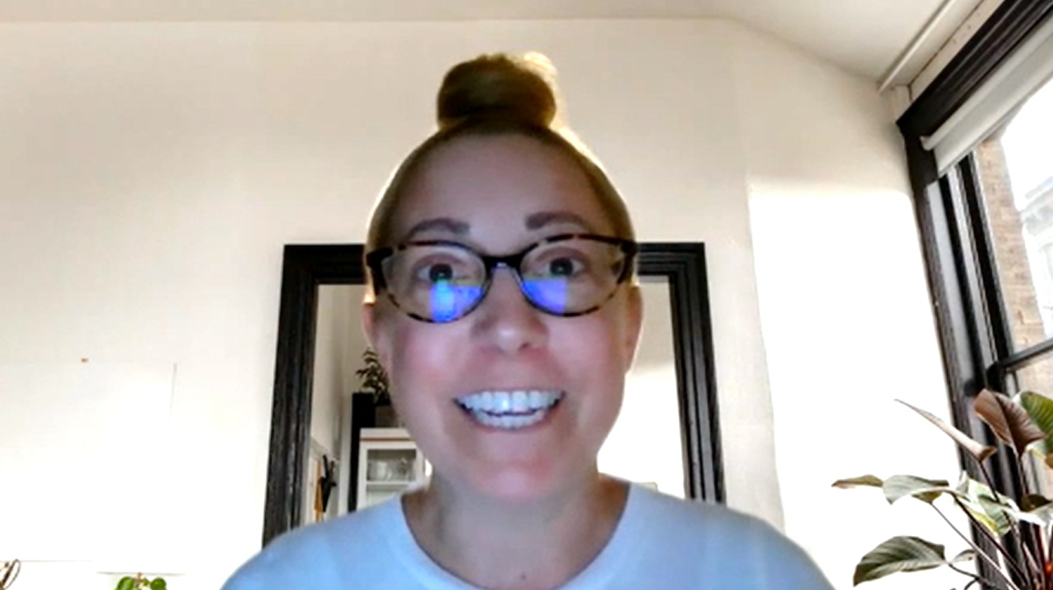
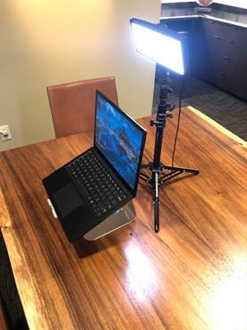
Key Learnings
Lock Content and Rehearse
Don’t Translate, Remake
Re-think your runway
The relationship between the audience (Camera) and the presenter must be more intimate/authentic

Slide 9
Key Learnings
Don’t Translate, Remake
Re-think your runway
Earn attention, Keep attention

Slide 10
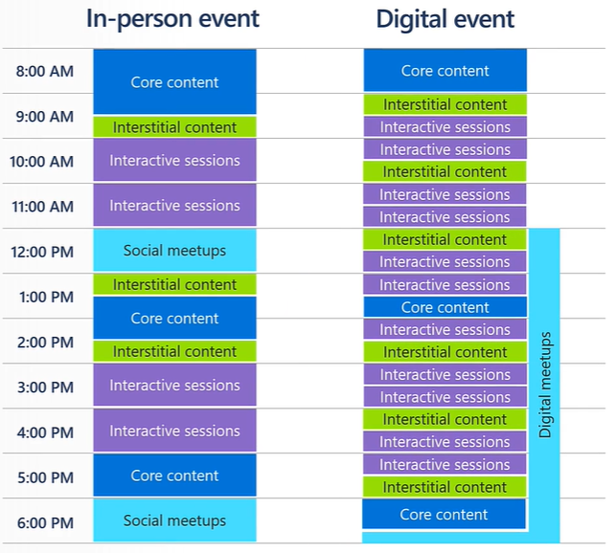
Key Learnings
Shorter is better
Don’t Translate, Remake
Re-think your runway
Earn attention, Keep attention

Slide 11
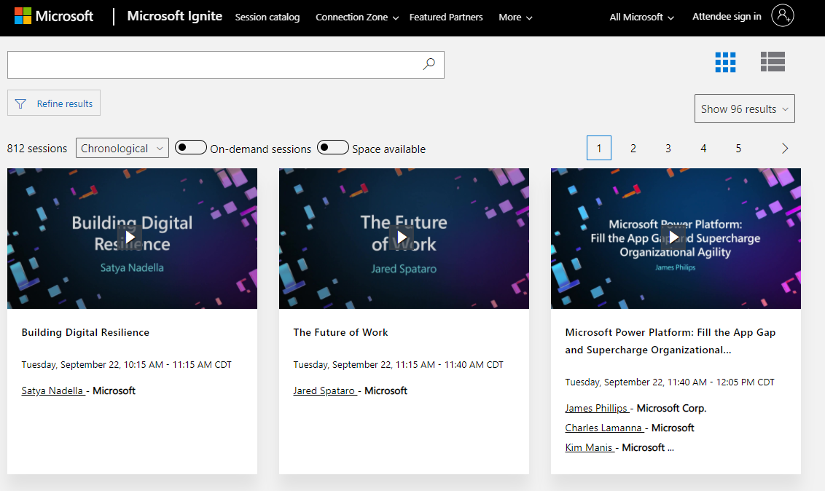
Key Learnings
Creating downloadable deep-dive content or references for follow-up after the event.
Don’t Translate, Remake
Re-think your runway
Earn attention, Keep attention

Slide 12
Key Learnings
Don’t Translate, Remake
Re-think your runway
Earn attention, Keep attention
Connect with your audience

Slide 13
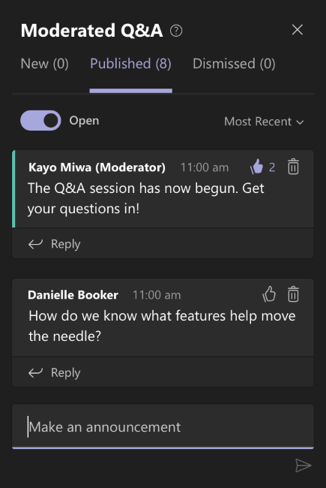
Key Learnings
Separate Speaker, Moderator, and Troubleshooter
Don’t Translate, Remake
Re-think your runway
Earn attention, Keep attention
Connect with your audience

Slide 14
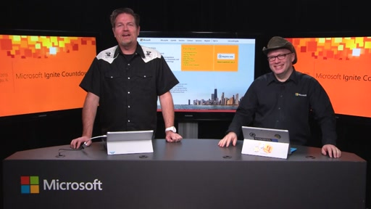
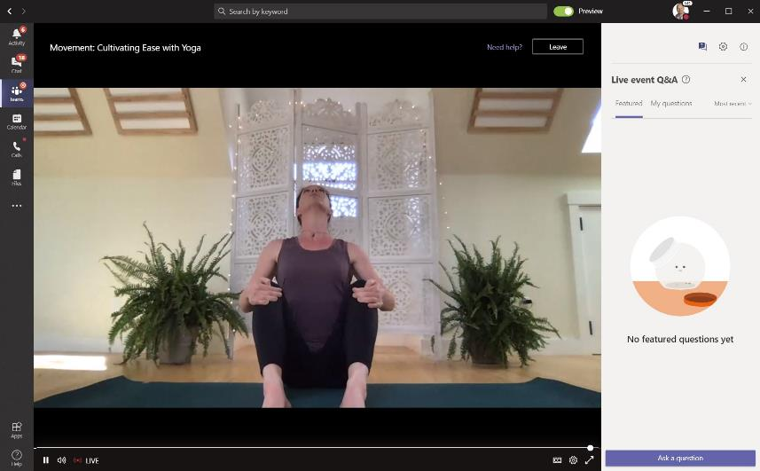
Key Learnings
Interstitial Content and “Hero Stream”
Don’t Translate, Remake
Re-think your runway
Earn attention, Keep attention
Connect with your audience

Slide 15




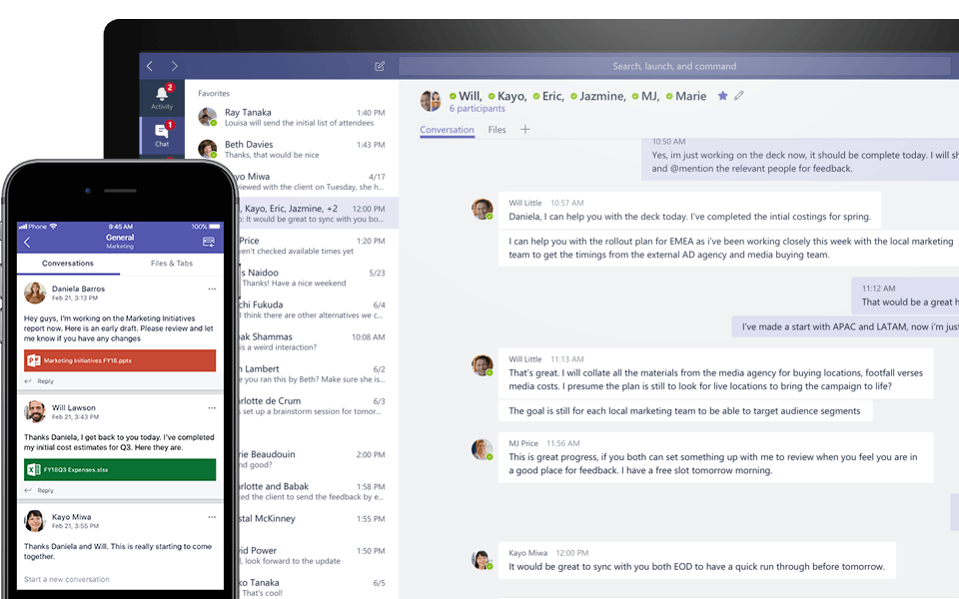
Key Learnings
Leverage Social Media, Chat and Communities
Don’t Translate, Remake
Re-think your runway
Earn attention, Keep attention
Connect with your audience

